Slide 1

Installation guide

Slide 2
- Introduction
- Steps
Download JDK
Clone Repository from Github
How to build
JVM option
Starting ‘Pizza-shop’ application

Slide 3
Introduction
This guide is for whom are attending Pinpoint Workshop on Nov 2
Title : "Hands-on Pinpoint Plugin Workshop: How to trace your system down to the code level ”
Link : https://coscon2019.sched.com/event/WgdC/hands-on-pinpoint-plugin-workshop-how-to-trace-your-system-down-to-the-code-level
We advice you to read following installation pages and be ready for the workshop.
You will need
- jdk
- IDE (any IDE you want)
- git
In your system.

Slide 4
Installation
Download JDK
JDK 6~9 is necessary for the full build of Pinpoint. But for this workshop we will only use 8
You can download JDK 8 from the Internet.
Oracle JDK link : https://www.oracle.com/technetwork/java/javase/downloads/jdk8-downloads-2133151.html
Open JDK link : https://openjdk.java.net/install/
Setting Environment Variable
JAVA_HOME environment variable set to JDK 8 home directory.
JAVA_6_HOME environment variable set to JDK 8 home directory.
JAVA_7_HOME environment variable set to JDK 8 home directory.
JAVA_8_HOME environment variable set to JDK 8 home directory.
You can download JDK 6~9 and set the variables to each home directory.
Or you can just link all to JDK 8 for the workshop as above.

Slide 5
Installation
Clone from Github
You can use git to clone from prepared git repository
Repository link : https://github.com/pinpoint-plugin-workshop/pinpoint-plugin-workshop.git
Code Description
We will use current(2019.10) master branch
We have removed tiny portion of the code for the workshop to proceed smoothly
Included 3modules, workshop-pizza-counter, workshop-pizza-oven, workshop-pizza-shop for the workshop
workshop-pizza-counter : library to instrument for the first plugin development
workshop-pizza-oven : oven instance will receive http call from shop instance
workshop-pizza-shop : shop instance is where Pinpoint-Agent and newly developed plugin will instrument

Slide 6
Installation
Build Pinpoint
Build Pinpoint using maven command
> ./mvnw install –DskipTests=true
Running pizza-shop application with Pinpoint-agent attached
you can use any application name you want for $APP_NAME and $AGENT_ID
Run below command from workshop-pizza-shop directory
> java -javaagent:$AGENT_DIR/pinpoint-bootstrap-1.9.0-SNAPSHOT.jar -Dpinpoint.applicationName=$APP_NAME -Dpinpoint.agentId=$AGENT_ID -jar target/workshop-pizza-shop-1.0.0.jar
Creating request
Sending request to pizza-shop through API
> GET http://localhost:8080/orderPizza?name=$NAME&count=$COUNT

Slide 7
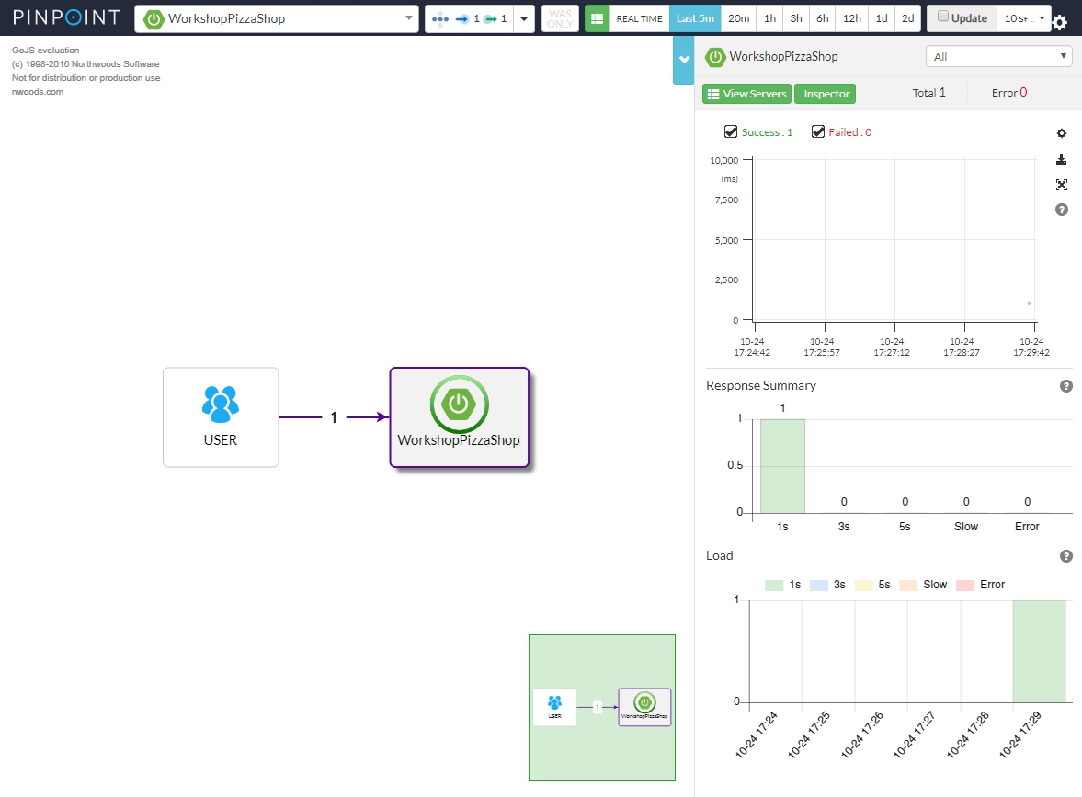
Installation
Check on Pinpoint Web
We already have deployed Pinpoint-Collector and Pinpoint-Web.
If you have successfully brought up Pizza-Shop application with Pinpoint-Agent attached
After sending a GET request as guided in the last page, you will be able to select your application and see just 1 node in the Pinpoint-Web we’ve prepared.
Link : http://125.209.240.10:10137

Slide 8
THANK YOU

